Slide 1

ARKANSAS MOVIE DATABASE
IFSC 4398
Presented By -
Rukshar Parwin

Slide 2
Topics
Introduction
Why we need a website
Project Approach
Assumptions and Risks
User Interface (Admin/ non-admin users)
Conclusion

Slide 3
Introduction
Arkansas's uniquely diverse landscape and unspoiled beauty offer more effective and dramatic settings than most other locations.
Arkansas provides visionary producers with seamless and efficient single-contact access to production houses, skilled crews, casting agencies and the resources that help filmmakers get from script to wrap party.
This website is intended for filmmakers who are interested to explore filmmaking in Arkansas.
The website is designed to provide previous successful projects that has ties to Arkansas either through its actors, or the location, and provide contact information that can connect filmmaker to talented, deepening crew base with potential workforce development incentives for studio and series productions.

Slide 4
Why we need a website
Just like how a painter needs a brush, paint and a canvas, a filmmaker needs a writer, a cinematographer, a sound mixer, production designer, editor, actors, distributors and an audience – it cannot be done alone.
Consistency with providing this valuable information is an important aspect so everyone is working with the same data and insights..
These data, when used effectively, is a valuable asset that will help Arkansas Film commission perform better, drive unrealized revenue, and boost customer satisfaction.
In the digital age where customers have high expectations of brands, they quickly notice inconsistencies. However, when data is centralized, it’s easier to deliver the same messages and experiences consistently.

Slide 5
Why we need a website
Top 5 reasons for a business or organization to centralize data of their interest:
Helps optimize Data Assets
2) Enhanced Consistency
3) Focus on What’s Important
4) Enhanced Customer Experience
5) Saves Time and Money.
Source: Mark Smallcombe, writing for Xplenty website (https://www.xplenty.com/blog/top-5-reasons-to-centralize-data/)

Slide 6
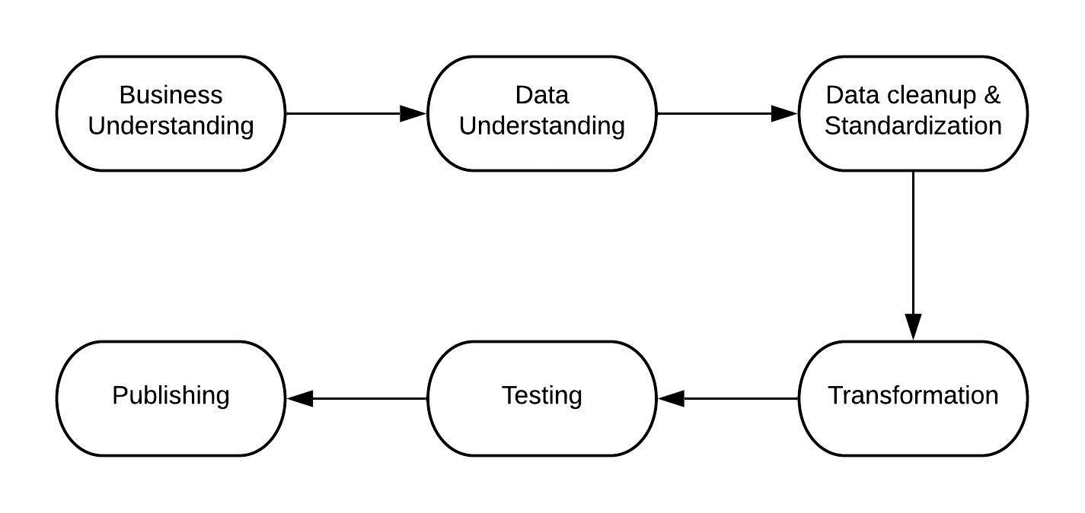
Project Approach
The approach of this project development was taken keeping in mind the central need of the project, i.e., to provide filmmakers interested in Arkansas to navigate previous successful projects,

Slide 7
Assumptions and Risks
Unifying feature of users will be people interested in films in AR. The website relies on the data extracted from Encyclopedia of AR and themoviedb.org
Assumptions:
The data captured in themoviedb.org is accurate.
The data captures all the information related to actor, actress, and location with ties to Arkansas.
Risk
If there are future changes to these resources in terms of their data collection or accessibility, that will impact the project.

Slide 8
Platform
All Development is done in a powerful yet easy to learn low code OutSystems environment.
This development is using OutSystems cloud, with free 2GB storage space and SQL Server backend.
This 2 minutes introduction video perfectly captures OutSystems capability:
https://www.youtube.com/watch?v=0gx3hMMDOZI

Slide 9
User Interface
Admin User Access:
https://personal-lyxnqufg.outsystemscloud.com/ARMDB/ArkansasmovieList.aspx?(Not.Licensed.For.Production)
Non-Admin User Access:
https://personal-lyxnqufg.outsystemscloud.com/ARMDB/PublicHome.aspx

Slide 10
Conclusion
OutSystems is an easy-to-use technology that can develop a functioning website. It provides the most complete full-stack application development platform that can quickly create mobile and web applications for any device.
The most appealing feature using OutSystems was the Drag-and-drop UI, business processes, logic, and data models to create full-stack, cross-platform apps with the option of adding your own code when needed.
Accuracy of the information requested was the focus of the system. The system presented will provide those benefit and also solve problems such as data accessibility, easy to use interface, and centralizing all the information.

Slide 11
Thanks

